Slide 1
CUSTOMER RETENTION AND LOYALTY
Submitted by
M.S.Jishnu
(Data Trained)

Slide 2
3 Stages of the Customer Lifecycle
1.Customer acquisition
2.Customer retention aims to keep a high proportion of current customers by reducing customer defections.
3.Customer development aims to increase the value of those retained customers to the company.

Slide 3
Contents of a Customer Retention plan
1.Which customers should be targeted for retention?
2.What customer retention objectives should be set?
3.What customer retention strategies will be used?
4.How will the performance of the retention plan be measured?

Slide 4
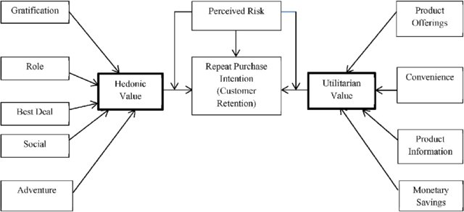
Simple customer retention definition
Customer retention is the number of customers doing business with a firm at the end of a financial year expressed as percentage of those who were active customers at the beginning of the year.

Slide 5
The appropriate time frame
Depends on re-purchase cycle found in the industry.
●Insurance policies are renewed annually.
●If the normal replacement cycle is four years, then retention rate is more meaningful if it is measured over four years.

Slide 6
Can you tell if a customer has defected?
May not be able to measure retention and defection if you have
●Product-based views of customers
●Channel-based views of customers
●Separate customer records in sales, marketing and service

Slide 7
Three measures of customer retention
Raw customer retention rate.
●the number of customers doing business with a firm at the end of a trading period expressed as percentage of those who were active customers at the beginning of the period.
Sales-adjusted retention rate.
●the value of sales achieved from the retained customers expressed as a percentage of the sales achieved from all customers who were active at the beginning of the period.
Profit-adjusted retention rate.
●the profit earned from the retained customers expressed as a percentage of the profit earned from all customers who were active at the beginning of the period.

Slide 8
Retention issues
Retention measures should be made with an understanding of customer profitability issues
The fundamental purpose of focussing CRM efforts on customer retention is to ensure that the company maintains relationships with strategically significant customers.
It may not be beneficial to maintain relationships with all customers. Some are
●too costly to serve
●strategic switchers constantly in search of a better deal
●not strategically significant in roles such as benchmark, door opener, inspiration or technology partner

